Slide 1
Developing Integration Solutions using Microsoft BizTalk Server 2016
Day 3 Key Learnings

Slide 2







Where are adapters placed?

Slide 3
What is an adapter?
.NET or COM components
Allows BizTalk to communicate over some kind of protocol with another system
Can support a one way or two way Message Exchange Pattern (MEP)
Can handle metadata and message context
Adapter

Slide 4
Where do I get adapters?
Out of the box – delivered with BizTalk
Extra adapters downloadable from Microsoft
Line of Business Adapters
BizTalk Adapter Pack 2.0
Other adapters
Offered by third party ISV’s.
For example /n software
Through the community
For example the null, Tcp/ip, TALK adapters, among others.
Custom Adapters
Build it yourself using one of the available framworks.

Slide 5
Different kinds of adapters
Adapters are what enables BizTalk to communicate with applications through a multitude of protocols and methods without effort
Adapter Type | Description
Protocol Adapters | To bridge heterogeneous technologies and protocols Examples: REST, HTTP, SFTP, SMTP, SOAP/WCF, and MSMQ
Data Adapter | To connect to specific databases Examples: SQL Server, Oracle, and DB2
Application adapter | To connect to packaged and proprietary applications Examples: SharePoint, SAP, JDE, PeopleSoft, and Siebel

Slide 6

The ABC of WCF
Windows Communication Foundation (WCF) is a runtime and a set of APIs for exchanging messages.
WCF was designed according to the tenets of service orientation.
WCF services can expose one or multiple endpoints.
Every endpoint is defined by 3 elements:
A: Address
B: Binding
C: Contract
C
B
A
A
B
C
WCF
Service
Client
Address
(Where)
Binding
(How)
Contract
(what)

Slide 7




BizTalk, WCF and ABC
Receive Port
Receive Location
Adapter
Service
Transport channel
The Adapter defines:
A (adress) = WHERE?
and
B (binding) = HOW?
but not C
C (contract) = WHAT?
Decoding
Channel
Channel
Channel
Dispatcher
BizTalkServiceInstance
Body/Envelope/XPath
The Pipeline (Disassembler) discovers:
C (contract) = WHAT?
Pipeline
Map
Message Box

Slide 8
WCF Adapters
Adapter | Host Type | Description
WCF-NetTcp | In-process | Uses the WCF NetTcpBinding, allows integration with WCF clients
WCF-NetNamedPipes | In-process | Uses the WCF NetNamedPipesBinding, allows fast communication to same machine services
WCF-WsHttp | Isolated | Uses the WCF WsHttpBinding, allows integration with compatible WS-* stacks
WCF-BasicHttp | Isolated | Uses the WCF BasicHttpBinding, allows integration with WS_BaseProfile1 compatible stacks
WCF-NetMsmq | In-process | Uses the WCF NetMsmqBinding, allows integration with WCF MSMQ clients
WCF-Custom | In-process | Allows you to use any Binding hosted by BizTalk
WCF-CustomIsolated | Isolated | Allows you to use any Binding in an Isolated Host
Notes:
Each are equivalents to the OOB WCF bindings

Slide 9
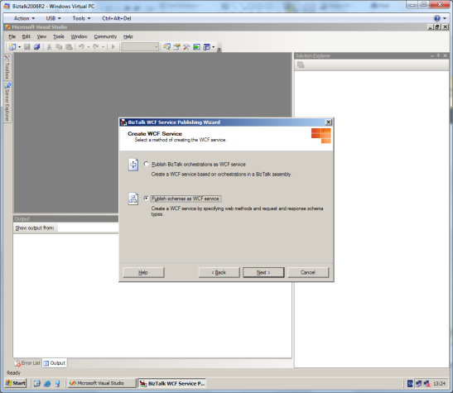
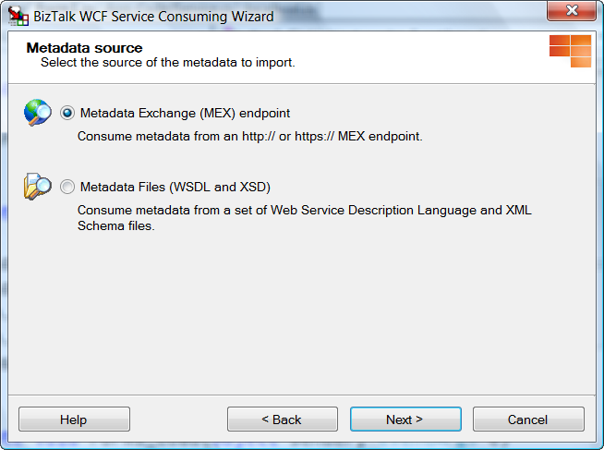
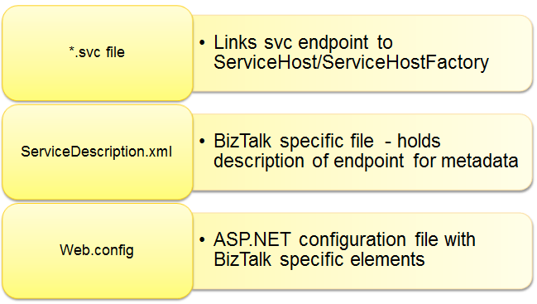
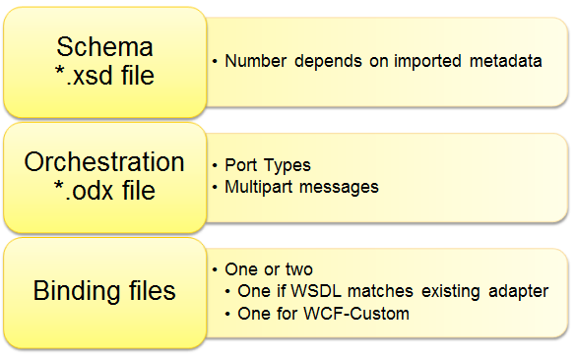


Wizards
WCF Consuming Wizard
WCF Publishing Wizard

Slide 10
Course Outline
Module 1: Introduction to BizTalk Server
Module 2: Schemas
Module 3: Maps
Module 4: Testing and Deploying Projects
Module 5: Pipelines
Module 6: Routing
Module 7: Adapters
Module 8: Web Services and WCF
Module 9: Introduction to Orchestrations
Module 10: Applied Orchestration Techniques
Module 11: Business Activity Monitoring
Module 12: Integrating Business Rules
Module 13: Deploying and Managing Applications
Module 14: Working with Workflow and AppFabric
Thursday

